Slide 1

Digital Banking System
By:
Linor Ben Yossef: 207331182

Slide 2
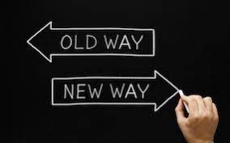

Introduction
Actor Table
Use Case Diagram
Send Money
Receive Money
View Account
D.O.M
SCOPE:
This Digital Bank is a basic digital bank.
The Bank includes customers and employees.
The customer can open/view/edit/close an account, transfer money and request a loan.
The employee can view the customer data and accept the customer’s loan requests.
This Bank’s scope does not include loan histogram, issuance of checks, issuance of credit cards, physical meeting arrangements with employees and stock investments.
We won’t support secure connections either (secured login, replay attacks, etc…)
The Send money function will not check if the destination account exists or if it got the money after successful transmission to the Global Banking System, but when we receive money to a non-existing account, we will return it to its source.

Slide 3
Actor Table
Introduction
Actor Table
Use Case Diagram
Send Money
Receive Money
View Account
D.O.M
Goals | Primary / Support | Description | Actor Name
Manage the customer’s account (Transfer Money, Ask for loan etc). By using this system, the customer can do everything he could have done with other physical banks, but digitally. | Primary | The Main audience. The Account belongs to the customer. | Customer
---- | Support | Monitor customers accounts and Approve customer’s loans. | Employee
---- | Support | A central system that all banks are linked to, while communicating with each other about transactions between accounts. | Global Banking Systems
---- | Support | The Time actor will initiate a functional operation every interval of time | Time

Slide 4
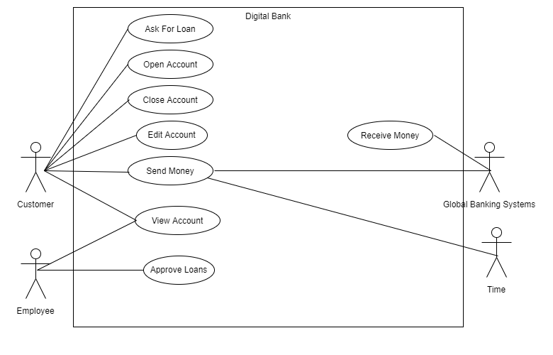
Use Case Diagram
Introduction
Actor Table
Use Case Diagram
Send Money
Receive Money
View Account
D.O.M

Slide 5
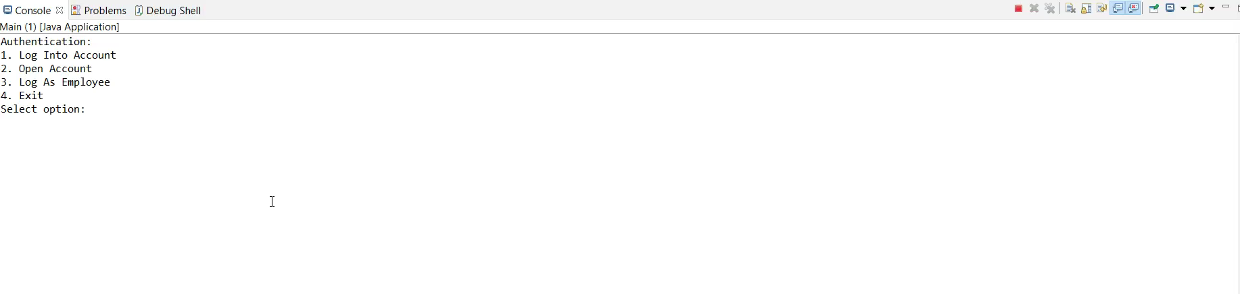
Send Money- Video
Introduction
Actor Table
Use Case Diagram
Send Money
Receive Money
View Account
D.O.M

Slide 6
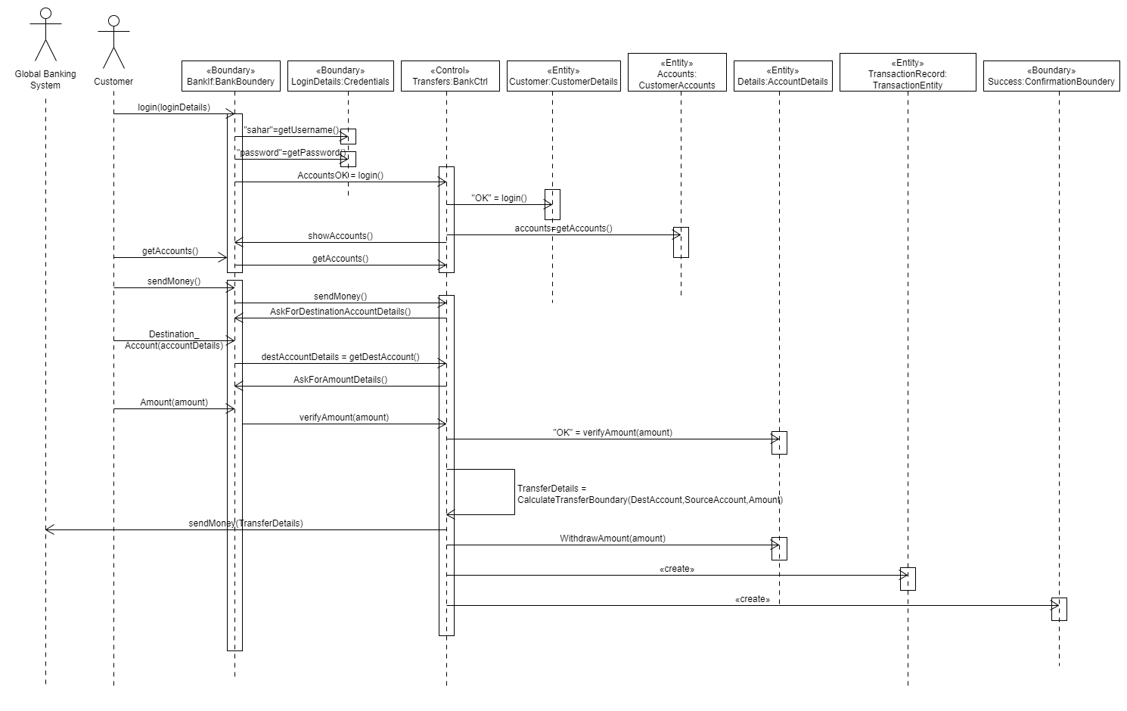
Send Money- Sequence Diagram
Introduction
Actor Table
Use Case Diagram
Send Money
Receive Money
View Account
D.O.M

Slide 7
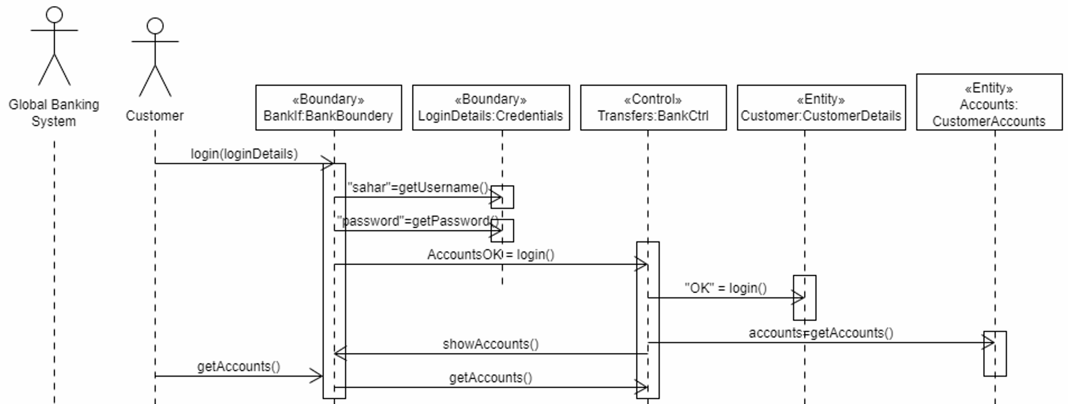
Send Money- Sequence Diagram – Login to account
Introduction
Actor Table
Use Case Diagram
Send Money
Receive Money
View Account
D.O.M
Account Focus
Login

Slide 8
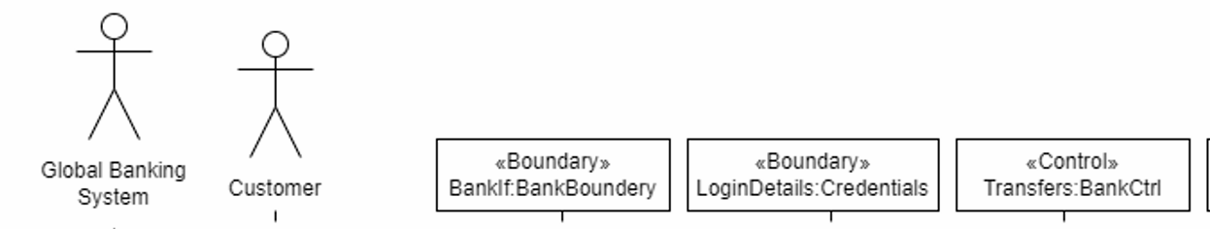
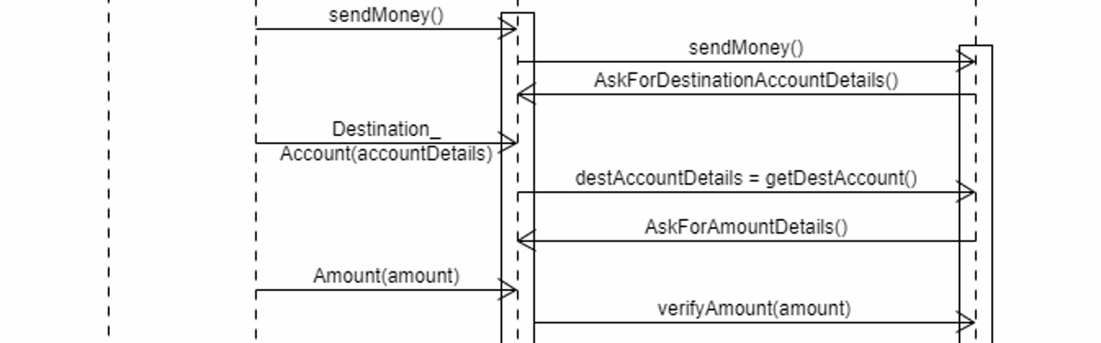
Send Money- Sequence Diagram – Enter details
Introduction
Actor Table
Use Case Diagram
Send Money
Receive Money
View Account
D.O.M

Slide 9
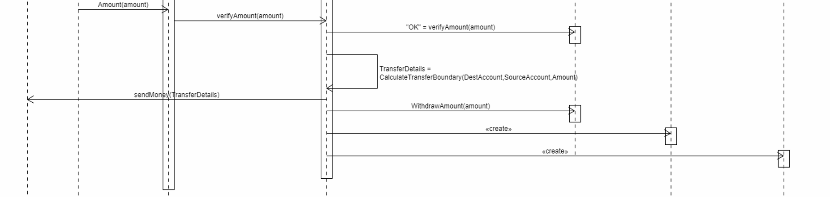
Send Money- Sequence Diagram – send money
Introduction
Actor Table
Use Case Diagram
Send Money
Receive Money
View Account
D.O.M

Slide 10
Send Money- Changes from documentations to implementation
Introduction
Actor Table
Use Case Diagram
Send Money
Receive Money
View Account
D.O.M
Our documentation system design was different from our code implementation basically because of:
The documentation system design was in general: every object in the sequence diagram was a basic object while when we’ve coded, we found out that many classes will be easier to code if we will split tasks.
Our communication as a team – every person has his own vision of how the code should look like, and how the system need to work

Slide 11
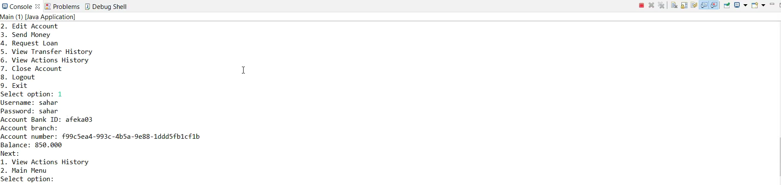
Receive Money- Video
Introduction
Actor Table
Use Case Diagram
Send Money
Receive Money
View Account
D.O.M

Slide 12
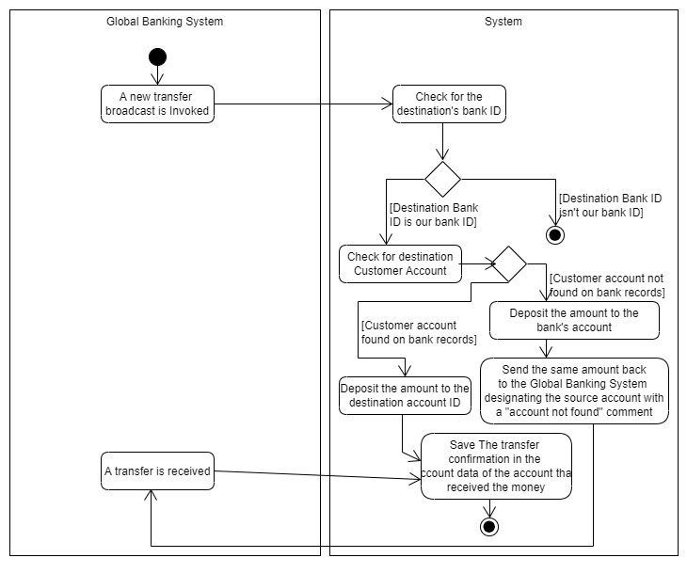
Receive Money- Use Case
Introduction
Actor Table
Use Case Diagram
Send Money
Receive Money
View Account
D.O.M
Goals: Give the Customer the option to ask for a loan.
Participating actors: Customer (Primary)

Slide 13
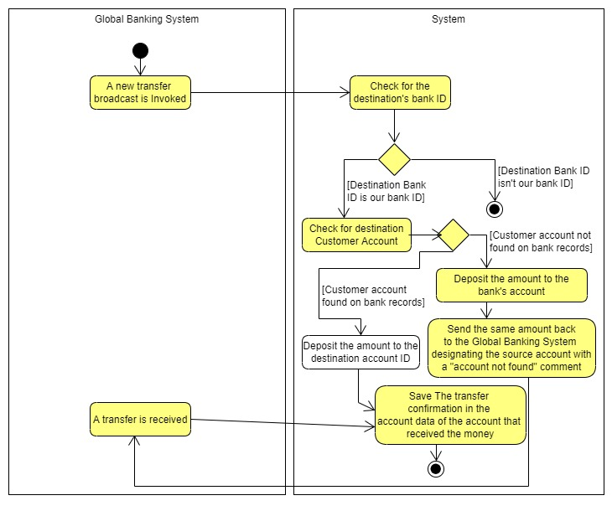
Receive Money- Alternate Flow Use Case
Introduction
Actor Table
Use Case Diagram
Send Money
Receive Money
View Account
D.O.M

Slide 14
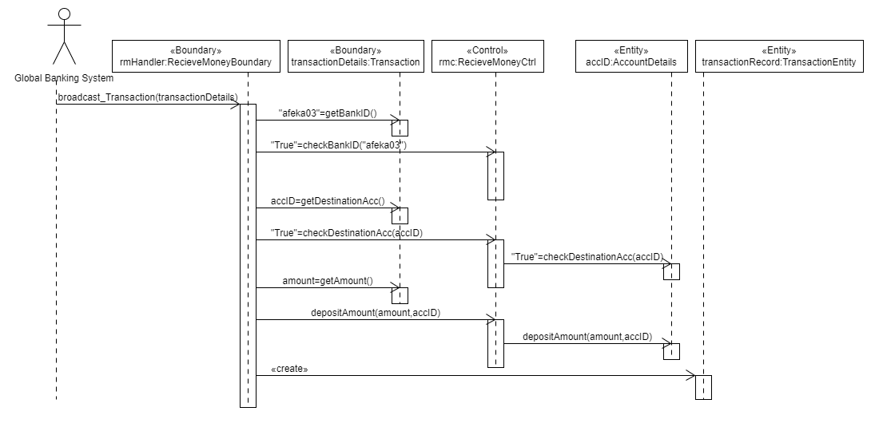
Receive Money- Sequence Diagram
Introduction
Actor Table
Use Case Diagram
Send Money
Receive Money
View Account
D.O.M

Slide 15
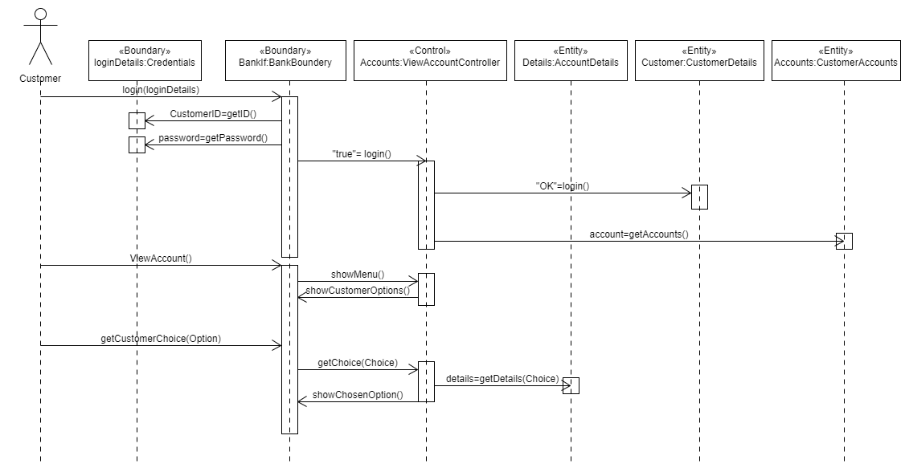
View Account- Sequence Diagram
Introduction
Actor Table
Use Case Diagram
Send Money
Receive Money
View Account
D.O.M

Slide 16
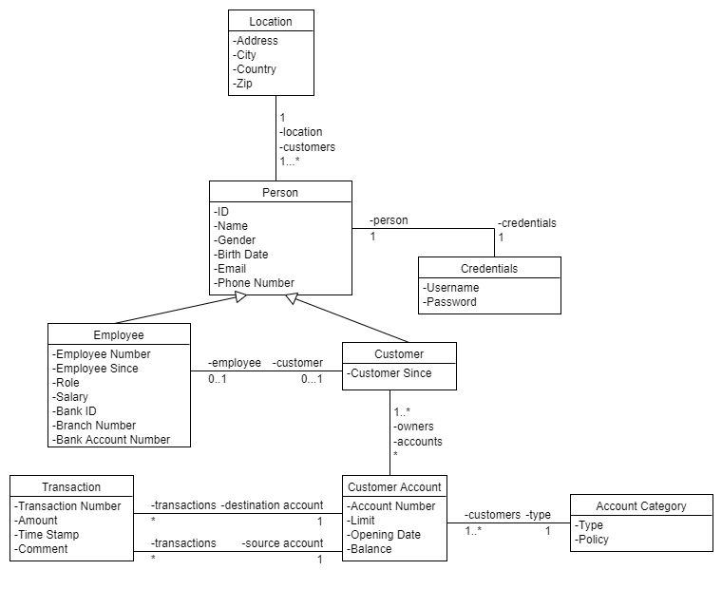
Domain Object Model
Introduction
Actor Table
Use Case Diagram
Send Money
Receive Money
View Account
D.O.M
Notes:
Employee has bank account details because we want the bank to transfer his salary automatically, while the employee’s bank account is not necessarily in our bank.
Loans are a private case of the transfer entity, implemented via timed transfers and recorded in the comment that it is a loan( which part is paid of the loan).
Customer logs in to the system with his personal ID, while employees login to the system with their employee number. A customer can have a couple of accounts while an employee can have only 1 employee account (this is because we want to separate between the accounts in case of an employee that has an employee account and a customer account in the bank).

